Slide 1
SOLARSAFE – Dehumidification
James Edwicker, Zac Heggie, Josh Tuckwell

Slide 2
Josh – Concept Design
The design goal is to increase the drying performance of the fan system.
Restrictions on:
Power – Target of ~100W, with a strict maximum of 150W.
Cost – Any increase must be proportional to performance gains and remain affordable for sub-Saharan Africa.
Space and Mobility – The device must be portable to enable sharing between multiple farmers.

Slide 3
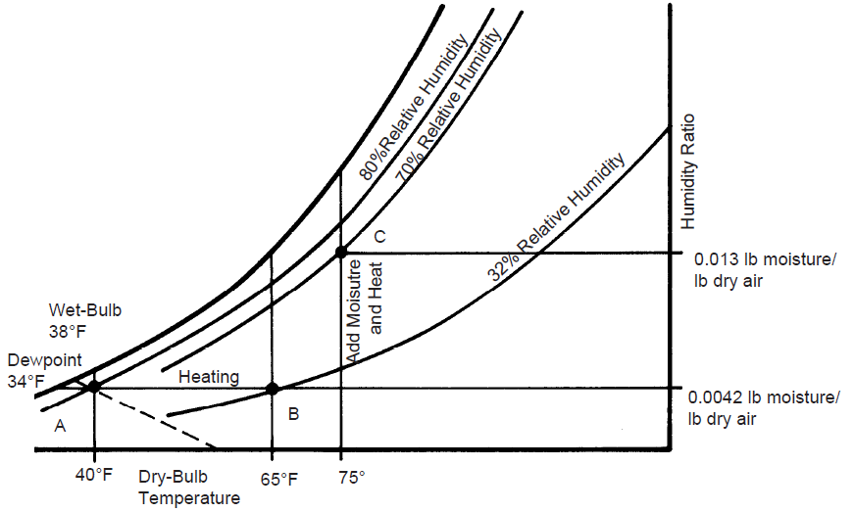
Josh – Concept Design
Brainstormed methods to increase drying performance:
Increase volumetric flow of air
Increase air temperature passing over the maize
Decrease inlet air humidity.
Found that increasing temperature by 1°C is equivalent to reducing humidity by 4%
Source: Penn State Extension, 2023.

Slide 4
Josh – Dehumidification
Desiccant Dehumidification: Uses moisture-absorbing materials (like silica gel). Requires regular physical replacement or a high-temperature cycle to regenerate the material.
Vapour-Compression Refrigeration: Drops air temperature below its dew point to condense out water. Highly effective but bulky, power intensive, and structurally complex.
Thermoelectric / Peltier Cooling: Solid-state condensation that strips moisture from the inlet air. No moving parts or toxic refrigerants.

Slide 5
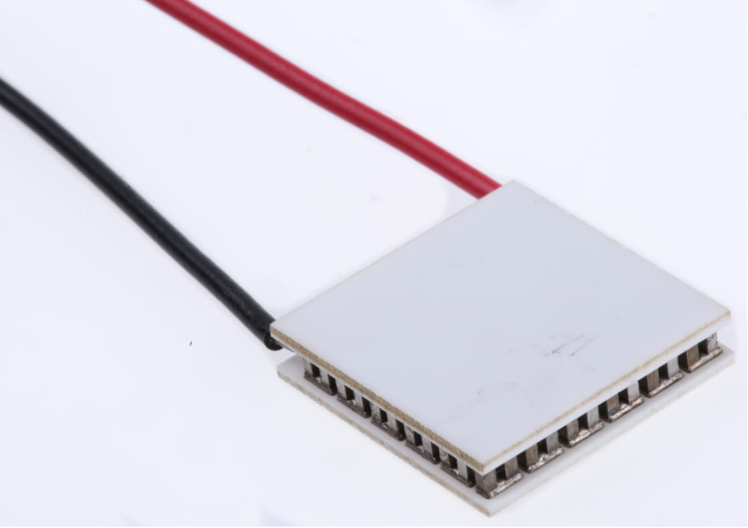
Josh – Peltier Devices
(
Thermoelectric modules which actively transfer heat from one side of the ceramic substrate to the other using a DC current.
Creates a local cold sink to drop inlet air below its dew point, forcing moisture to condense.
Key Advantages | System Limitations (Design Constraints)
Ultra-Compact | Low Thermodynamic Efficiency (COP) compared to mechanical cycles.
High Reliability: No compressors, valves, or fluid | Extraction rates are typically <1 litre of water per day.
Low Cost & Quiet | Optimised for small spaces

Slide 6
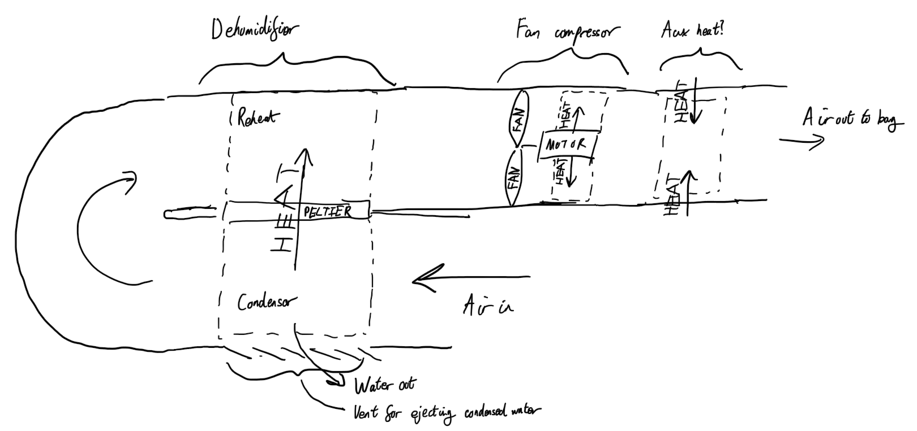
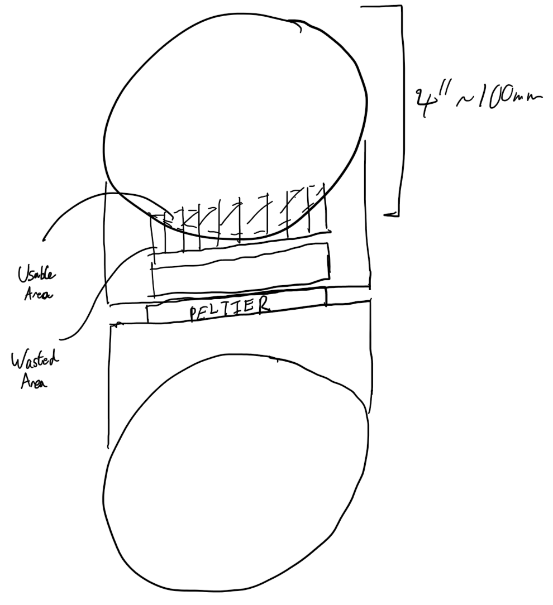
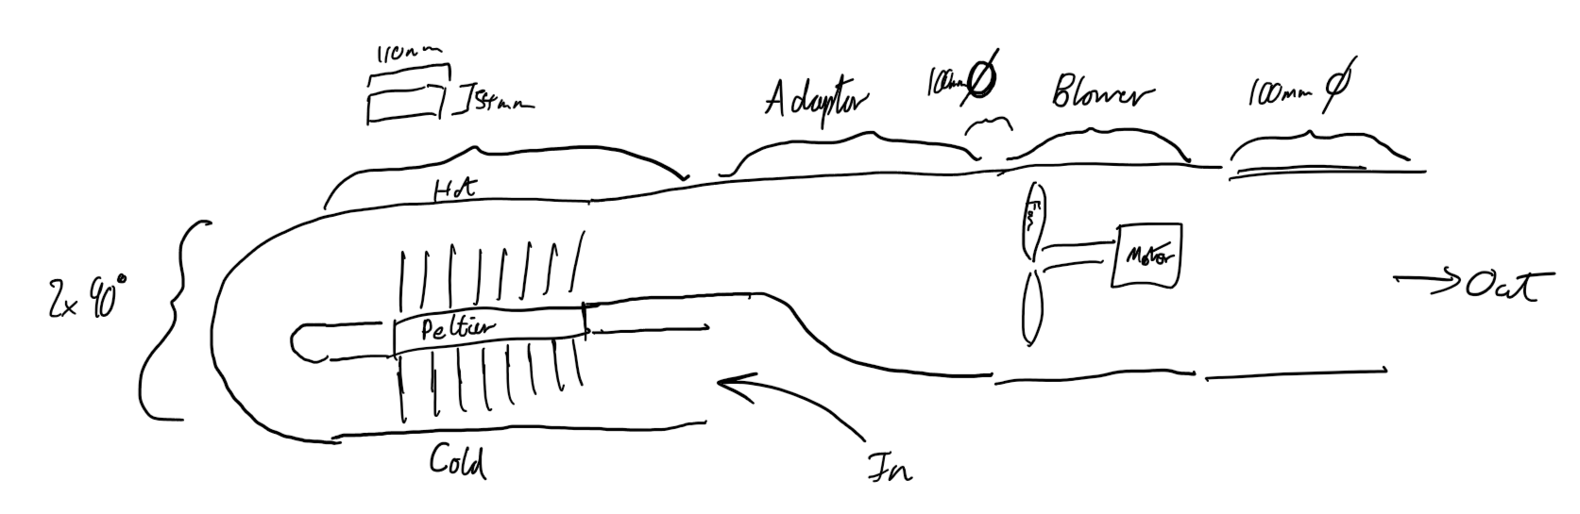
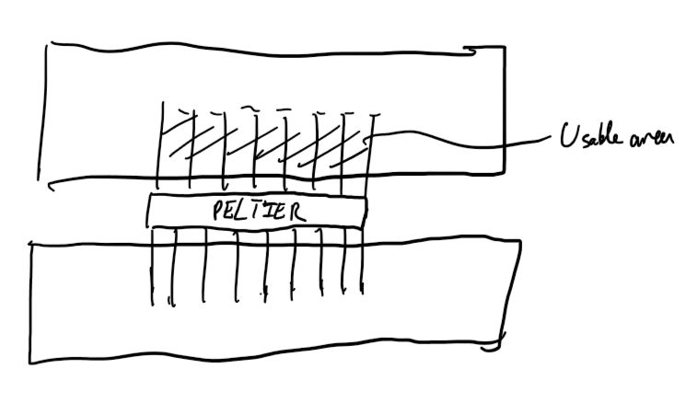
James – Rig Design
Motor & fan selection
Dehumidification parts
Ducting routing
Ducting cross-section
Water management
Air management

Slide 7
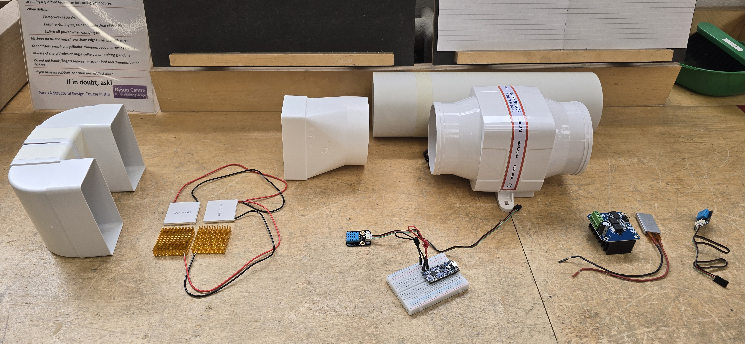
James – Rig Design
Peltier
Blower
180° Turn
Humidity & Temp Sensors
Temp Element
Controller

Slide 8
James – Risk Assessment and Parts Sourcing
Updating the risk assessment to meet departmental demands
Filtering material and parts options to find suitable purchases
Key issues:
Motor & fan
Ducts
Peltier heat sinks

Slide 9
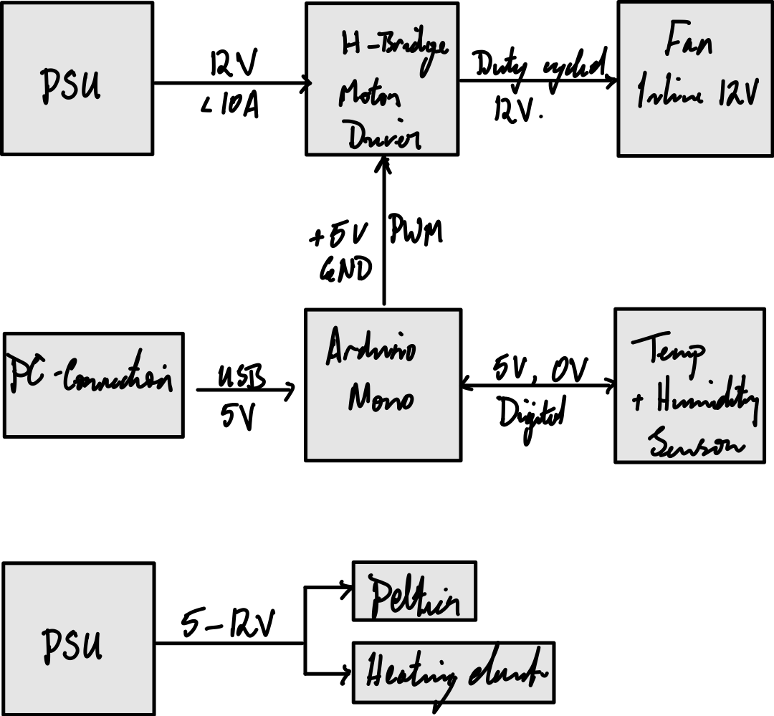
Zac – Electronics Architecture

Slide 10
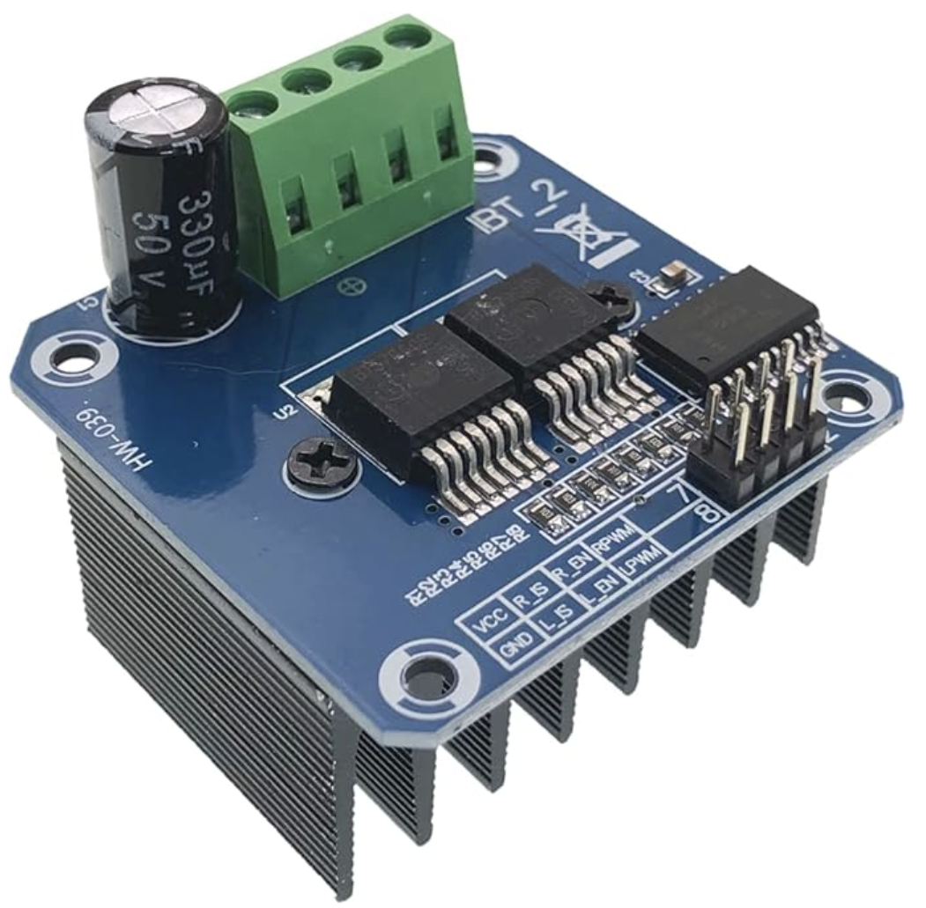
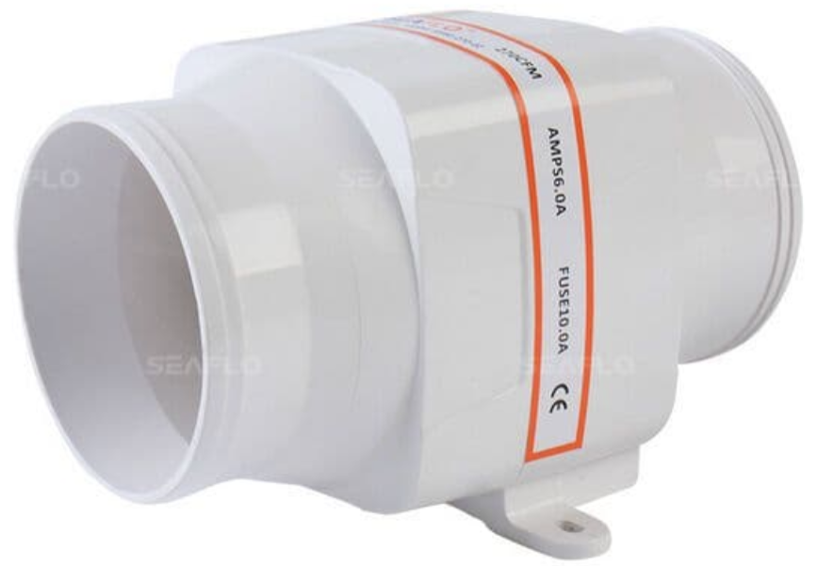
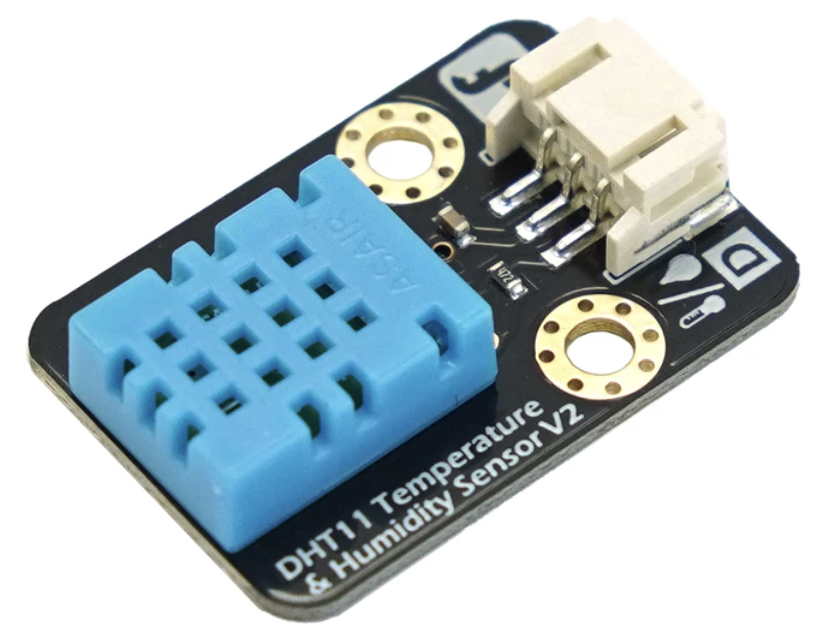
Zac – Devices
Gravity: DHT11 Temperature & Humidity Sensor For Arduino
High Power Double DC Stepper Motor Driver Module Board H-Bridge PWM
SEAFLO IN LINE BLOWER 12V 4" MARINE BOAT VENTILATION in-line air vent inline

Slide 11
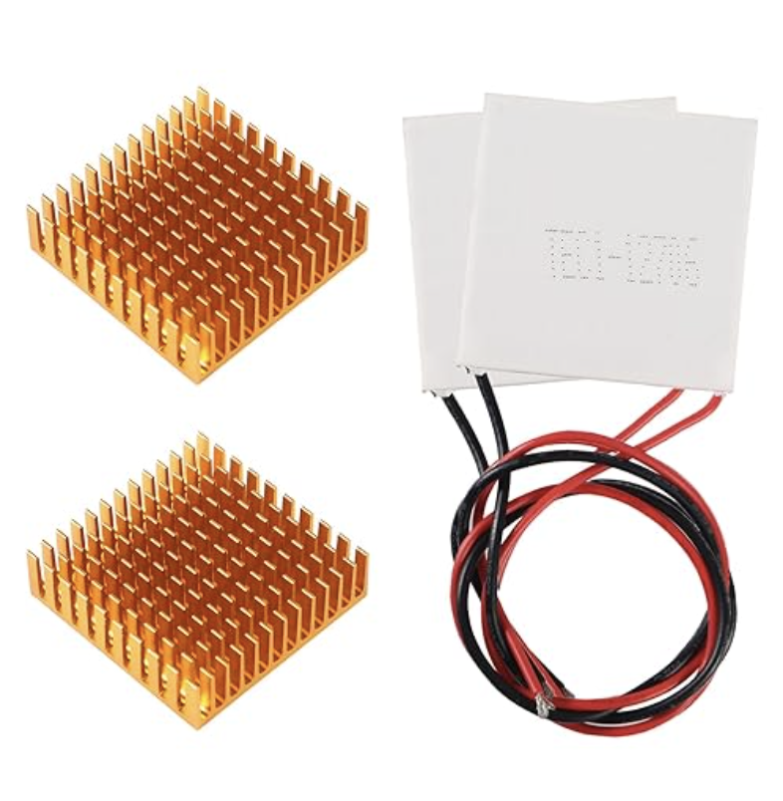
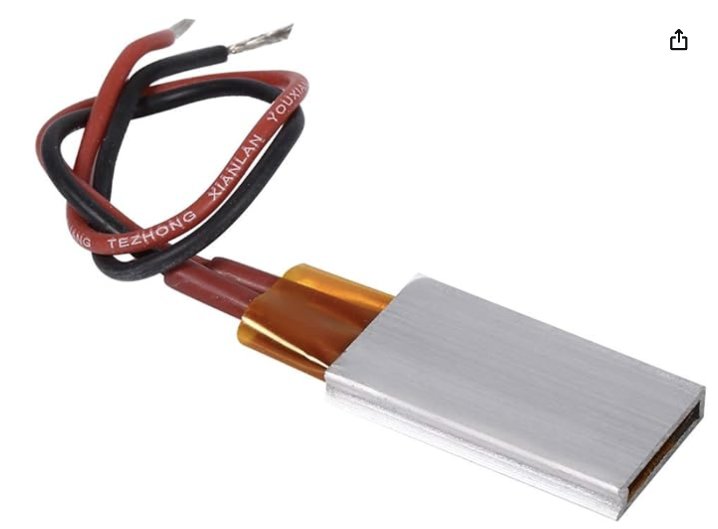
Zac – Devices
Thermoelectric Cooler Cooling Peltier Plate Module 12V 6A
12V AC DC Universal Constant Temperature Air Heater

Slide 12
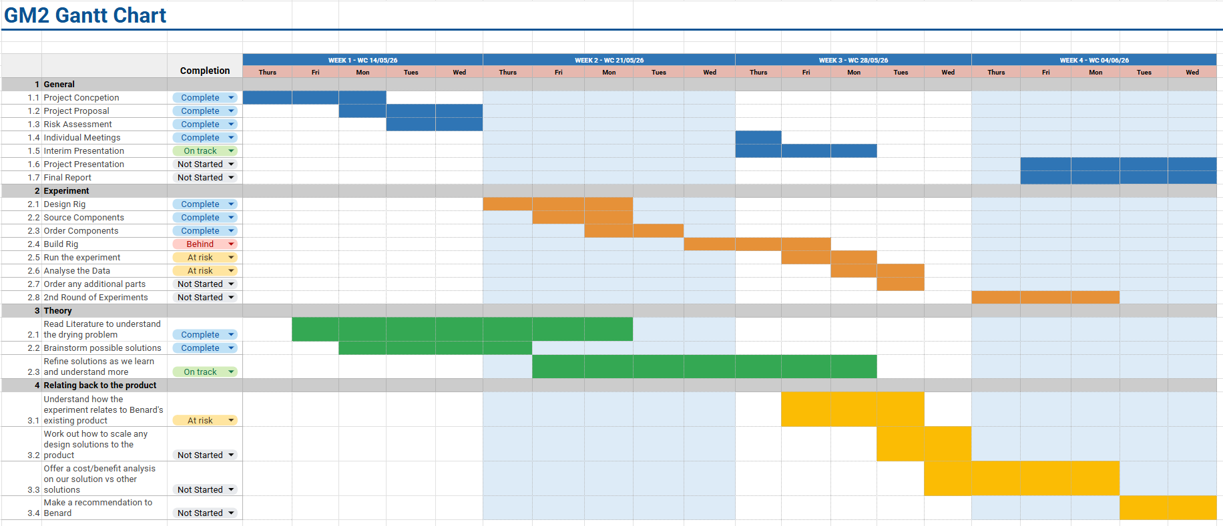
Project Timeline Update

